Slide 1
Cognos Analytics Overview

Slide 2
All the answers you need, in one place.

Slide 3

A long rich history of innovation
Impromptu
Powerplay
ReportNet
Cognos 11.1 AI infused
Cognos 8
Cognos 10
Build on a proven platform
Metadata Modeling
Content Administration
Alerts & Notifications
Search
Reporting & Dashboarding
Office Integration
Bursting & Scheduling
Collaboration
Governance and Security

Slide 4






Analytics the way you think?
Collect &
Organize
100’s
of questions
every day
10’s
of insightful
discoveries
Actionable
Insights
10’s
of decisions
influenced
100’s
of measured
outcomes
Automated Data Preparation
Data Exploration
AI Assistant
Advanced pattern detection
Predictive capabilities
Times Series Forecasting
Dashboards
Automated visualizations
Natural language generation
Open Source Visualizations
Storytelling
Collaborate through Slack
Managed Reporting
Guided layouts
Reuse existing components & styles
Going Beyond BI
Jupyter Notebooks & Python
Open Source Visualizations
IBM Planning Analytics
IBM Decision Optimization
Watson Studio & Watson M/L
Watson Applications
Natural language search
Auto-modeling
In-tool data preparation

Slide 5

Advanced Analytics Driven by AI
Prepare
AI-assisted and automated to easily cleanse and combine your data in minutes
IBM
Cognos Analytics
on-Cloud
Analyze
Guided exploration infused with augmented intelligence and machine learning to uncover hidden patterns and insights
Create
&
Share
Interactive dashboards, storytelling and pixel-perfect reporting to collaborate and share across your organization
INFUSE
Technology integration that allows you to infuse analytics into your business process

Slide 6

Latest Features of Cognos Analytics (CA)
Do Your Business Users Employ the Latest?
Automated Data Preparation
Data Exploration
Natural language search
Understand the meaning and intent of your search terms
Auto-modeling
Start faster with suggested ways to blend & join data
In-tool data preparation
saves time, effort & enhances accuracy
AI Assistant
Ask questions and get answers, naturally
Advanced pattern detection
Unearth hidden insights
Predictive capabilities
Highlight relationship strengths & key drivers
AI-detected
Makes sense of it faster with related insights
Times Series Forecasting
Dashboards
Managed Reporting
Going Beyond BI
Automated visualizations
System recommends optimum way to visualize
Natural language generation
Ask question in everyday language
Storytelling
Interactive narratives
Collaborate through Slack
Push annotated visuals & links to where people are
Guided layouts
Simplify creating pixel perfect content
Reuse existing components & styles
Quickly assemble new content
Other Features in Cognos Analytics
Jupyter Notebooks & Python integrations
Open Source Visualizations
Integrate with other IBM Technology
IBM Planning Analytics
IBM Decision Optimization
Watson Studio & Watson M/L
Watson Applications

Slide 7
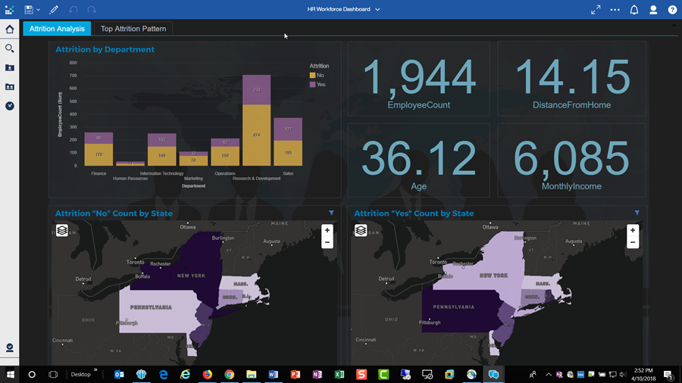
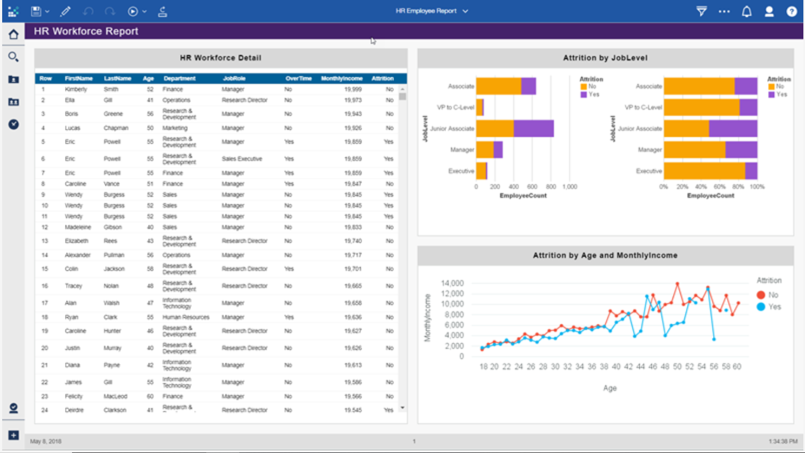
Reports vs Dashboards
Cognos Dashboards
Self-Service Data Visualization
Lightweight data shaping & cleansing
Automatic visualization connections
Simplified Layouts and Formatting
Data Source Flexibility
NLP Visualization Creation
When do I suggest one approach over the other?
Which agenda does your Customer have?
You need to understand the answer to the second question before you can answer the first
Common Elements
Drag-and Drop Data Analysis
Live Data Interactivity
Cognos Reports
Bursting
Pixel Perfect Output
Scheduled Delivery
Custom Scripting
Custom Query Authoring
SDK: Application Extensibility

Slide 8
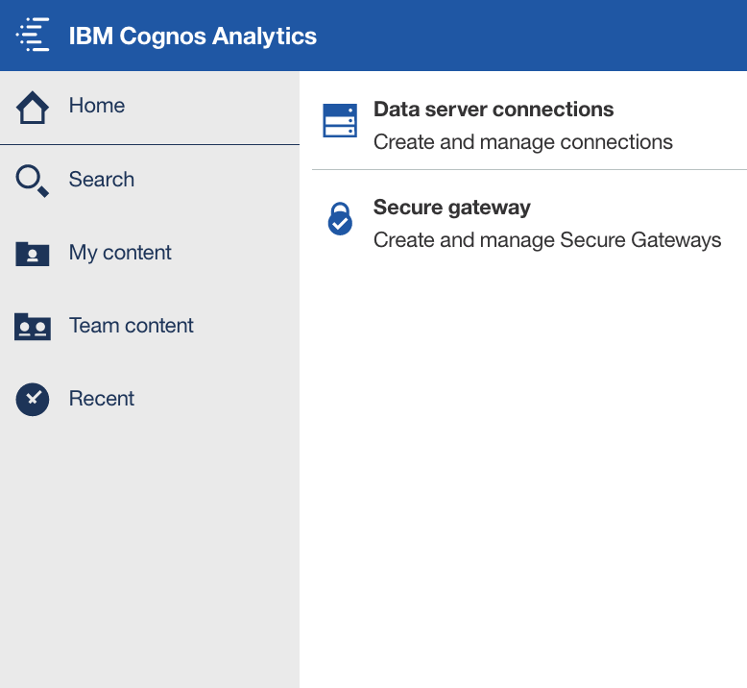
30-Day Free Trial
The full Cognos Analytics experience
Sign-up is easy and fast
Up to 5 users
Includes on-premises database connection
Convert directly into a paid subscription
Guided Tours
Users can take a guided tour through IBM Cognos Analytics.
Tours introduce you to different parts of the product at your own pace.
Guided interaction helps you learn more effectively.
Easy Provisioning
Create a subscription with different tiered users in a single order
Manage the assignment of tiers to people via their email address
Start your analytics journey!
Data Access
Cloud-based databases and uploaded data
Access on-premises data via a secure gateway
Analyze data from different sources at the same time
Self-service setup of up to 10 secured gateways

